Slide 1
Survivorship: Living Beyond Lung Cancer
Moira King, ANP

Slide 2
Survivors in US
As of January 2016, it is estimated that there are 15.5 million cancer survivors in the United States. This represents 4.8% of the population. The number of cancer survivors is projected to increase by 31%, to 20.3 million, by 2026, which represents an increase of more than 4 million survivors in 10 years
More than 14 million new cases of cancer are diagnosed globally each year; radiation-cure to 3.5 million people and provide palliative relief for an additional 3.5 million people

Slide 3
What is a survivor?
The most widely accepted definition of a "cancer survivor" is a person who has been diagnosed with cancer, starting the day of their diagnosis until the end of life.
Within this broad definition, a long-term cancer survivor has been defined as a person who is living five years after diagnosis with or without disease

Slide 4
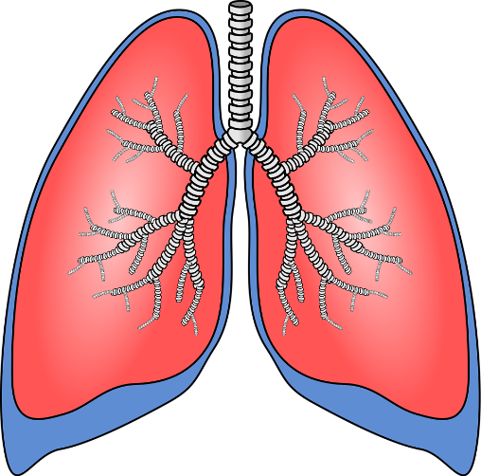
Thoracic cancers
Consisting of lung cancer, thymus cancer, and mesothelioma. Lung cancer is the most common type of thoracic cancer.
Symptoms include shortness of breath, wheezing, cough, hoarseness, bone pain and fatigue, loss of appetite.
As many as 20% of the people who die from cancer every year are never smokers.

Slide 5
Common long term effects of lung cancer treatment
● Sequelae from surgery most commonly can include chronic pain (including post-thoracotomy pain syndrome), and dyspnea.
-These can contribute to a sedentary lifestyle and decreased functioning ability. Nearly 80 percent of lung cancer survivors report some difficulty with a physical symptom, and this is clinically significant in approximately 30 percent of lung cancer survivors.

Slide 6
Common long term effects of lung cancer treatment
●Chronic pain is reported in approximately 50 percent of lung cancer survivors, specifically after a thoracotomy.
-Approximately one-half of lung cancer patients report inadequate pain control, and nearly 40 percent of long-term lung cancer survivors report chronic pain symptoms.

Slide 7
Common long term effects of lung cancer treatment
Fatigue is one of the most common post-surgical symptoms reported by lung cancer survivors (up to 90 percent in some studies)
- Fatigue is linked to depression, anxiety, chronic pain, psychological distress, dyspnea, and sleep disturbances.

Slide 8
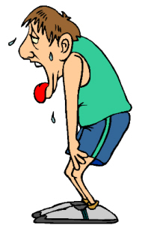
Common long term effects of lung cancer treatment
● Dyspnea is also common in lung cancer survivors.
-The American Thoracic Society (ATS) suggests the prevalence ranges from 55 to 87 percent in all stages of lung cancer.

Slide 9
Common long term effects of lung cancer treatment
Psychological distress — Up to 80 percent of lung cancer survivors experience psychological distress, and this rate is three times more common than observed among survivors of other types of cancers.
Although the cause of heightened distress in lung cancer survivorship is largely unknown, it may be associated in part with the poor prognosis and perceived stigma attached to this disease.

Slide 10
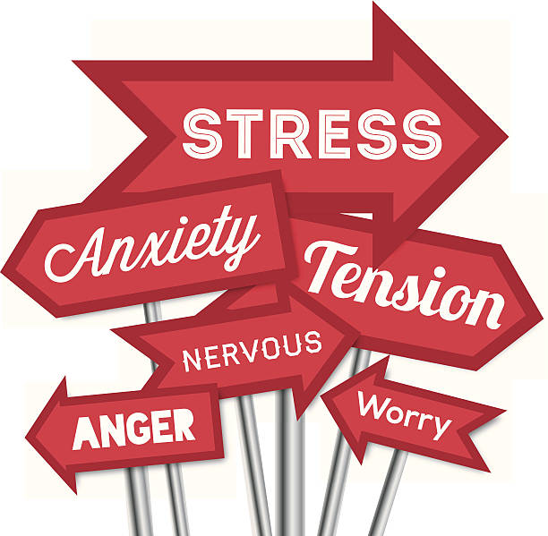
Common long term effects of lung cancer treatment
Psychological distress can include symptoms of generalized fear; specific fear of recurrence, sadness, worry, or uncertainty; stress, including relationship stress; poor sleep quality; lack of concentration; depression; and anxiety.
Among lung cancer survivors, heightened anxiety is correlated with an increase in physical symptoms and a decrease in overall functioning

Slide 11
Common long term effects of lung cancer treatment
Stigma:
Given that lung cancer is highly linked with tobacco smoking, lung cancer patients report that others tend to assume they are at fault for getting lung cancer.
Stigma is more strongly associated with lung cancer than other cancers. Stigma can have a negative effect on lung cancer patients' psychological well-being and has been associated with anxiety and depression.

Slide 12
Common long term effects of lung cancer treatment
Stigma (continued)
Perceived stigma can lead to social isolation, and avoidance, which sometimes discourages patients from seeking medical care and psychosocial support.
Anti-tobacco campaigns that may be decreasing smoking there is concern that these increase the stigma of lung cancer.

Slide 13
Common long term effects of lung cancer treatment
Physical activity —
Physical activity among lung cancer survivors is low, both shortly after the end of the treatment and years after treatment.
Long-term lung cancer survivors who report more physical activity reported significantly better quality of life in all five measured domains (mental, physical, emotional, social, spiritual), less difficulty with symptom control, and decreased pain severity compared with those who were not physically active

Slide 14
Services Offered in Lung Survivorship Clinic:
Nurse Practitioner visit with assessment and plan
Lung Cancer Surveillance
CT scan every 6 months until 2 years post op, and yearly after
Referrals based on patient identified needs:
BeFit program
Physical Medicine and Rehabilitation
Physical Therapy
Psychosocial Counseling
Nutrition
Pain Management
Smoking Cessation

Slide 15
Treatment Summary
Document provided to patient and PMD which includes:
Patient Demographics
Treatment Team
Family and Social History
Current diagnosis, pathology result, cancer staging, cancer histology, treatment (surgery/chemo/radiation)
Care plan for surveillance and screenings
Treatment related effects
Lifestyle recommendations
Resources

Slide 16
Clinic goals
GOAL: to help patients manage issues that arise from treatment in order to improve overall well being and quality of life
Cancer survivorship begins at diagnosis and continues throughout a person’s lifetime
Cancer can affect people physically, emotionally, mentally, financially. It also affects families and relationships
Needs are different during treatment, after treatment, at initial diagnosis through end of life
Needs are unique to every patient

Slide 17
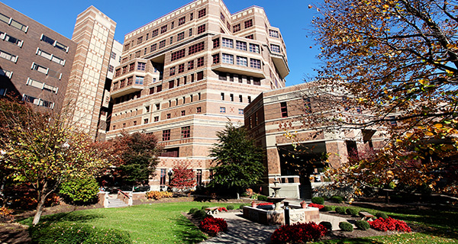
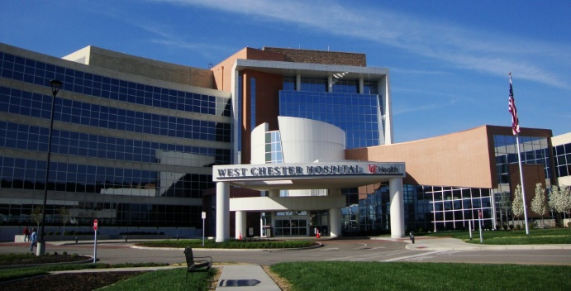
Lung Cancer Survivorship Clinic
Phone number: 513-475-8787
Main location: Medical Arts Building UCMC 7th floor
WCH coming soon!
Open to ANY lung cancer patient at any point on their cancer journey

Slide 18
Thank you!

